Slide 1
Prediction of booking status and revenue optimization
By
-Devanshi Mehta

Slide 2
About the project
Objectives:
Predicting the cancellation status of bookings in hotel using two models: KNN, Random Forest
Optimize the revenue by reducing the loss/cost and increasing profits
Business Questions answered by this study:
Reasons for cancellation in reservations
Impact on revenue and increasing profits

Slide 3
About the dataset
Dataset source: Kaggle
The dataset is about reservation system in hotels/resorts
It includes many variables (32) some of which are:
Reservation status
Lead time
Previous cancellation status
Booking changes
Deposit

Slide 4
pipeline
Data Sourcing
Data cleaning
Exploratory Analysis
Data Modelling
Get the predictions and confusion matrix
Optimization

Slide 5
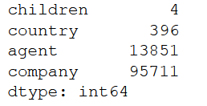
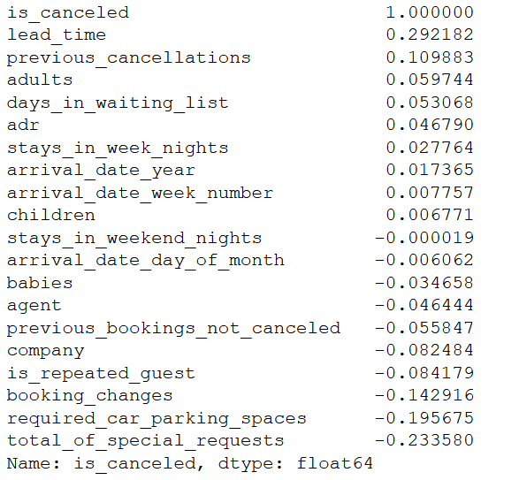
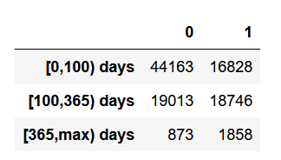
Data cleaning and eda

Slide 6
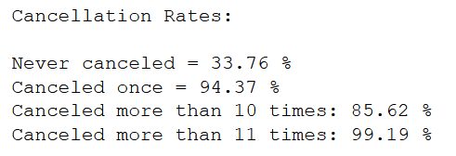
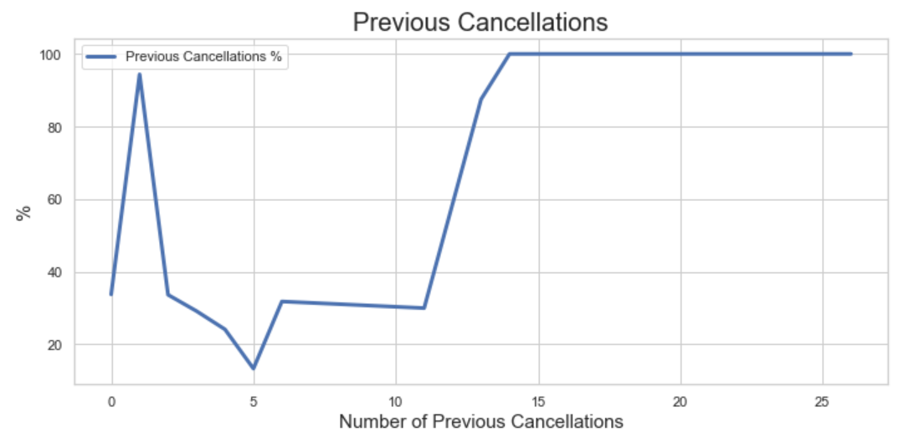
Data cleaning and eda

Slide 7
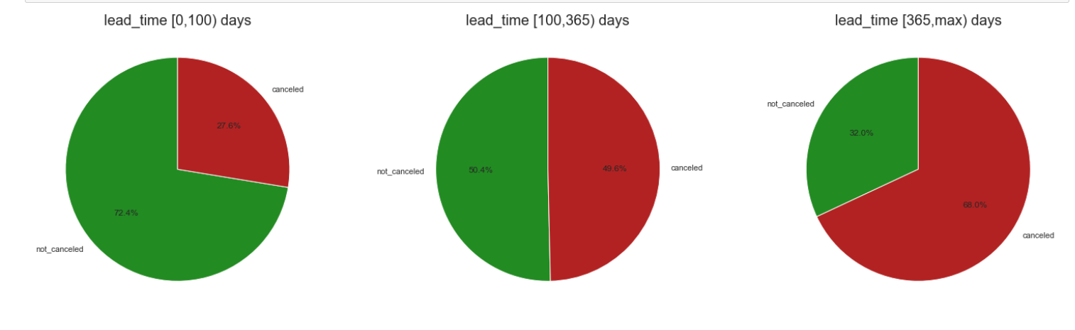
EDA
Most bookings occur about 5 days prior to arrival. When the lead time is larger the chances for cancellation increase. The amount of bookings is steady overall between 20-100 days, then drops.

Slide 8
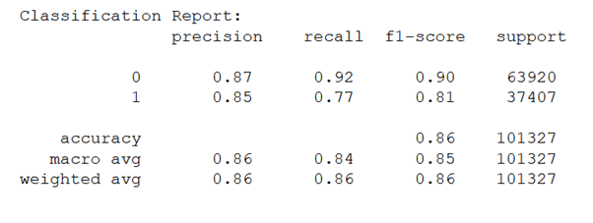
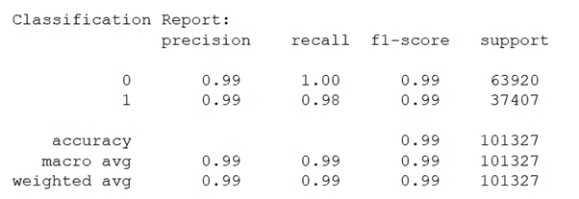
Results from prediction models
Results from K-NN
Results from Random Forest

Slide 9
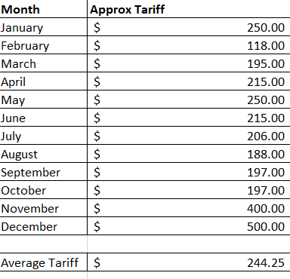
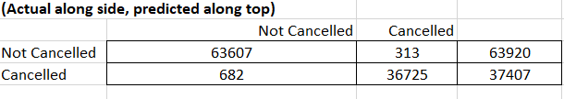

Results from optimization

Slide 10
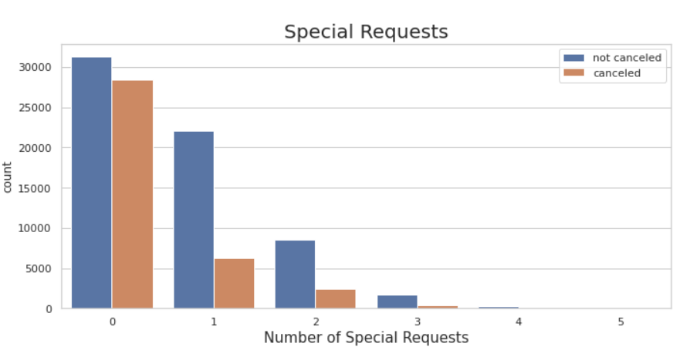
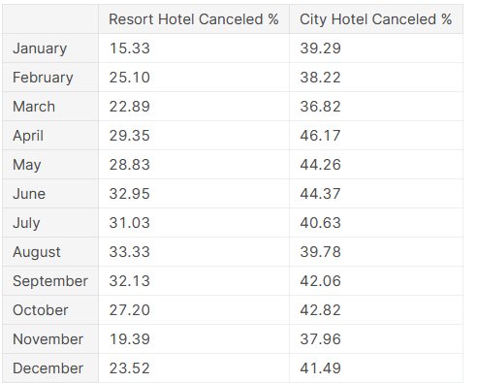
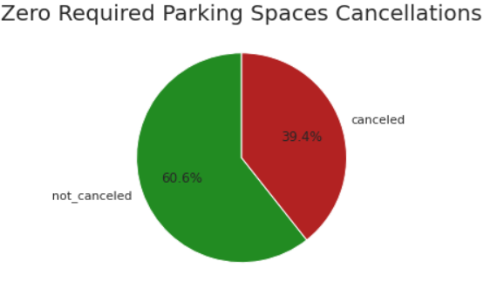
Business impact

Slide 11
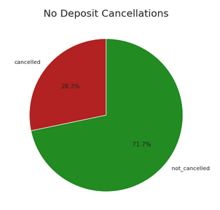
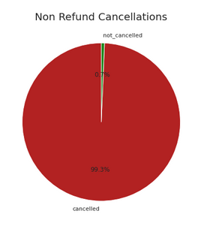
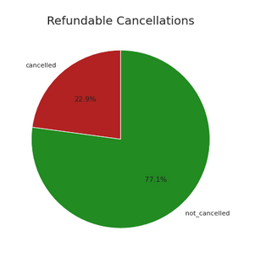
cONCLUSION
Market segment cancellation rates are highest amongst travel agencies and tour operators.
Distribution channel cancellation rates are highest amongst groups, travel agencies and tour operators.
Customer type cancellation rates are highest amongst transient (meaning the booking is not part of a group or contract and is not associated to another transient booking).

Slide 12
CONCLUSION
The reason for cancellation of bookings can be seen from the visualizations
The most common reason for cancellations is the room type
Based on the optimization model, if we correctly predict the reservation status, the hotel can make a revenue of a little over $15 million
Future Scope: Extrapolate similar study to other industries such as airline bookings or railway ticket bookings

Slide 13
Thank you!

